Slide 1


SRM VALLIAMMAI ENGINEERING COLLEGE
(An Autonomous Institution)
DEPARTMENT OF INFORMATION TECHNOLOGY
MINI PROJECT WORK
“REAL TIME LICENSE PLATE DETECTION USING TENSORFLOW AND TESSERACT”
BATCH NUMBER:22MP02
PROJECT MEMBERS
1)ISHWARIYA.P(412818205021)
2) LAKSHMI PRABHA.R(412818205034)
3)MYTHIREYENI.P.V.(412818205042)
4)NEELAVENI.M(412818205045)
UNDER THE GUIDANCE OF
Dr. A.R.REVATHI /ASSOCIATE PROFFESSOR.

Slide 2
INTRODUCTION:.
Used to detect unlicensed cars.
Used to simplify paper works and fines
Used to provide security in the society.
Used in toll plaza and border control.
Used to identify the Rash drivers.
Helpful in solving crime and accidental cases.
HIT-AND-RUN CASE SOLVED:
In California, a 76-year-old man was killed in a hit-and-run incident. Witnesses were able to capture a partial license plate number of the car, which was provided to cops. Equipped with this information, the cops used their LPR system to query the partial plate and the location of the hit within a 10-mile radius. The image results allowed the police to find the full license plate number, and eventually the location of the suspect.

Slide 3
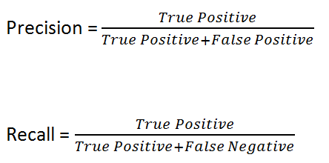
OBJECTIVE:
To make reliable detection rate above 99.62% using precision recall parameters

Slide 4
1.True positive(TP/TP+FN)
2.True negative(TP/TP+FN)
3.False positive(FP/FP+TN)
4.False negative(FN/FN+TP)
To achieve False positive rate of 1.675% for complicated images.
To achieve the accuracy Histogram of oriented gradients, Local binary pattern, Support vector machine and Extreme learning machine algorithms are used.

Slide 5
EXISTING SYSTEM :
S.NO | PAPER NAME | TITLE OF THE PAPER | YEAR | CONCEPT | CHALLENGES
1 | Borneo international conference- IEEE Access | Real time vehicle license plate detection by using convolutional neural network algorithm with tensorflow | 2018 | It propose vehicle license plates detection system by using convolutional neural network (CNN) with tensorflow | This have the accuracy around 70-99%
2 | International conference-IEEE Access | Real Time License Plate Detection Using OpenCV and Tesseract | 2017 | The CV2 OpenCV library using Python language is used for image processing and Tessaract is used for text extraction from the processed image | This have the accuracy around 89%

Slide 6
3 | International conference – IEEE Access | Automated license plate detection using a support vector machine | 2016 | SVM (Support Vector Machine) based on negative and positive examples is used to determine whether or not a candidate area is a license plate | The effectiveness of this method was confirmed to yield a license plate detection rate of approximately 90%.

Slide 7
CHALLENGES:
The effectiveness of support vector machine method was confirmed to yield a license plate detection rate of approximately 90%.
The false positive rate for complicated images is 1.675%.
quality of camera

Slide 8
PROPOSED SYSTEM:
Algorithm used:
1.HOG- histogram of oriented gradients.
2.LPB- local binary pattern.
3.Feature selection using SVM(support vector machine) and ELM(extreme learning machine)classifiers.
And also it is Implemented using tensor flow and Tesseract python libraries.
Dataset : An English car database including 510 vehicle images under different conditions. The LPD system the extended database also includes the rotated images with different LP angles, such as 45◦ , 30◦ , 20◦ , 15◦ , and 5◦ .
The dataset contains various illumination conditions with three LPs resolutions of 100 × 25, 200 × 50 and 300 x 75.

Slide 9
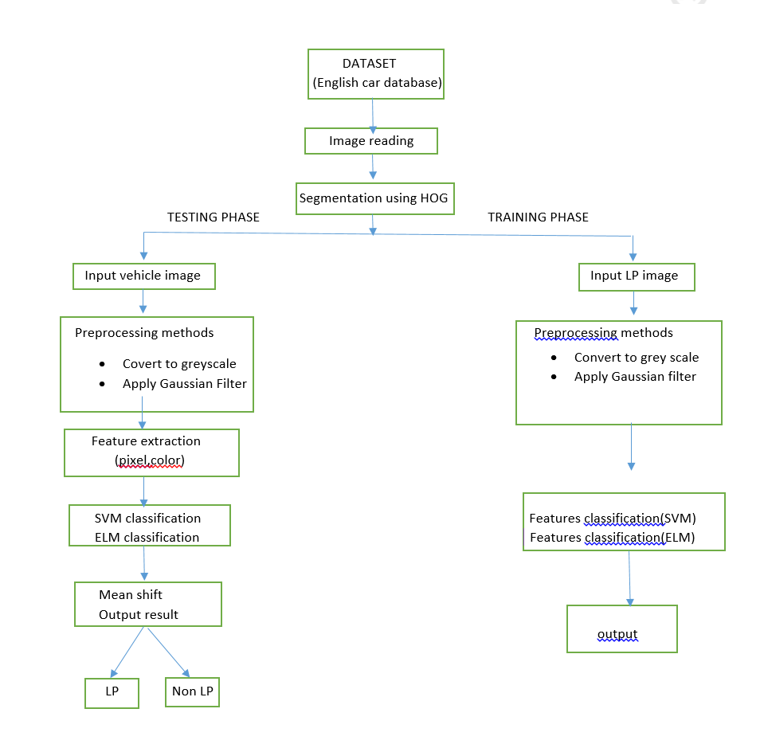
ARCHITECTURE :
Diagram:

Slide 10
SOFTWARE & HARDWARE REQUIREMENTS:
SOFTWARE:
Operating system: Windows, Linux ,IOS.
Languages: Programming language: Python
Libraries used: Tensor flow and Tesseract.
IDE: Pycharm, Anaconda environment.
HARDWARE:
Hard disk :Minimum 250GB
RAM: Minimum 4GB.
Camera: 16 megapixel (if required).

Slide 11
CONCLUSION:
To make reliable detection rate above 99.62% using precision recall parameters can be achieved.
Reduce 1.675% False Positive Rate.

Slide 12
REFERENCES :
Meeras Salman Al-Shemarry, and Yan li,Sept 2020,”Developing Learning-Based Preprocessing Methods for Detecting Complicated Vehicle Licence Plates”, This work is licensed under a Creative Commons Attribution 4.0 License. For more information, see https://creativecommons.org/licenses/by/4.0/ ,VOLUME 8, pp. 170951-170966.
Imam Taufiq, Dr. Bambang Purnomosidi, M. Agung Nugroho and Akhmad Dahlan,2018 ,“Real-time Vehicle License Plate Detection by Using Convolutional Neural Network Algorithm with Tensorflow”, 2nd Borneo International Conference on Applied Mathematics and Engineering (BICAME).
Shigeharu Miyata,2016,”Automated License Plate Detection Using A Support Vector Machine”,14th international Conference on Control Automation and Robotics & Vision Phuket.
Rahul R. Palekar, Sushant U. Parab and Dhurmil P. Parikh, 2017,”Real Time License Plate Detection Using OpenCV and Tesseract”,International Conference On Communication And Signal Processing.

Slide 13
THANK
YOU

